Slide 1

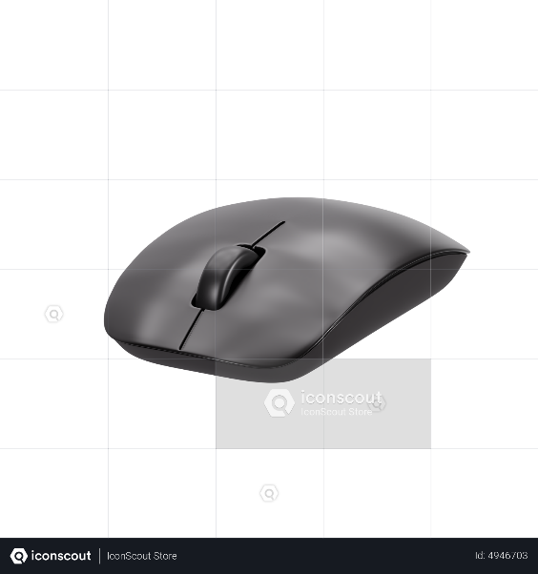

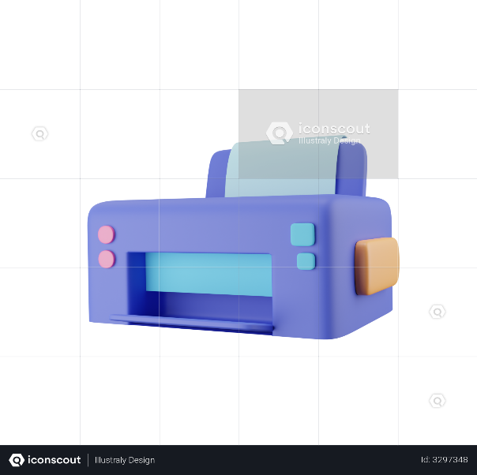
CONSUMER GOODS ANALYTICS

Slide 2
Problem Statement
Project overview
ATLIQ BUSINESS MODEL
Atliq hardware is
A leading hardware company
Specializing in PC’s printers,mice,
And computers with a global reach.
Atliq hardware is
a leading hardware producer,faced a critical challenge.
They need quick and data informed decision to stay competitive in this emerging market.
The management noticed that they were missing some crusial insights for strategic moves.
In this project I will be working on a dataset related to consumer goods.
The goal is very simple. We need to answer 10 AD-HOC queries using SQL queries.

Slide 3
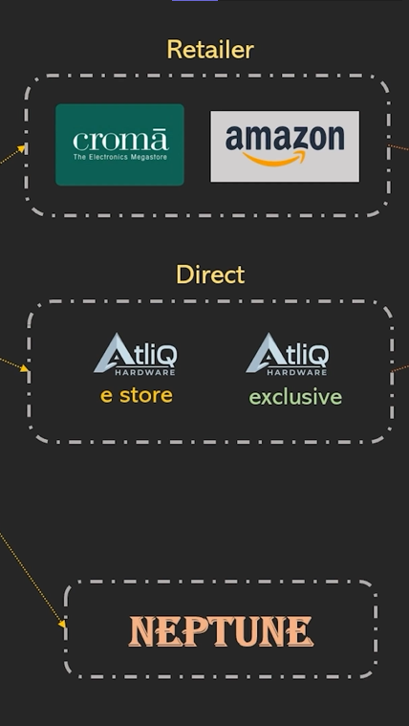
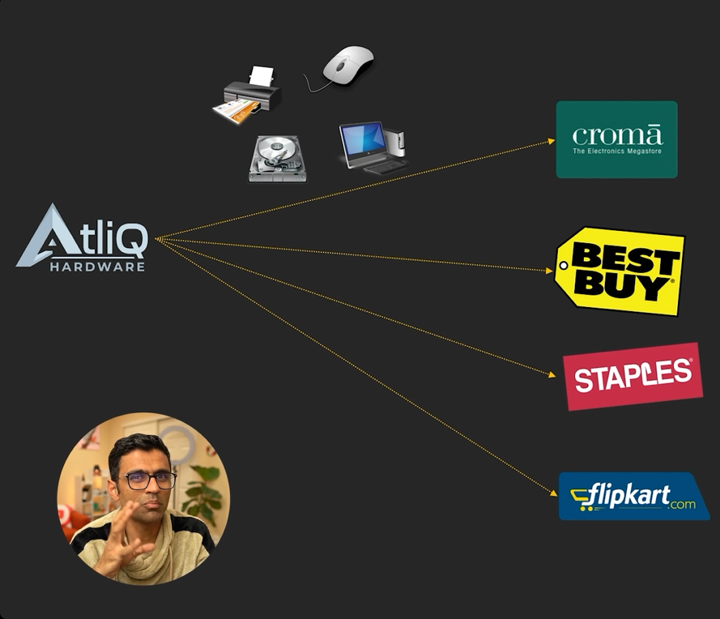
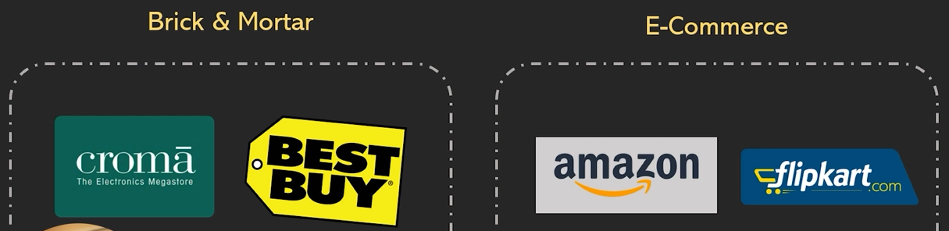
ATLIQ HARDWARE BUSNESS MODEL
Customers
Customers platform

Slide 4
DATA-SET
DATABASE-gdb023
Dim_customer
TABLES
Dim_product
Fact_gross_price
Fact_sales_monthly
Fact_manufacturing_cost
Fact_pre_invoice_deduction

Slide 5
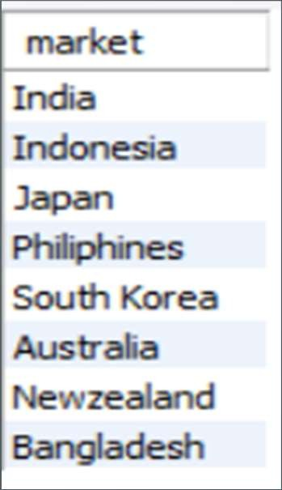
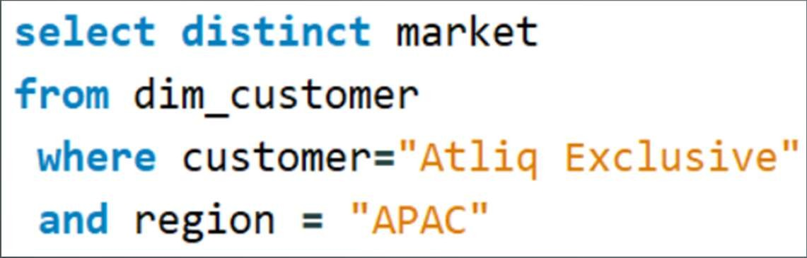
AD_HOC-REQUEST:1
QUESTION:
Provide the list of markets in which customer
"Atliq Exclusive" operates its business in the APAC region
Output
SQL Query

Slide 6
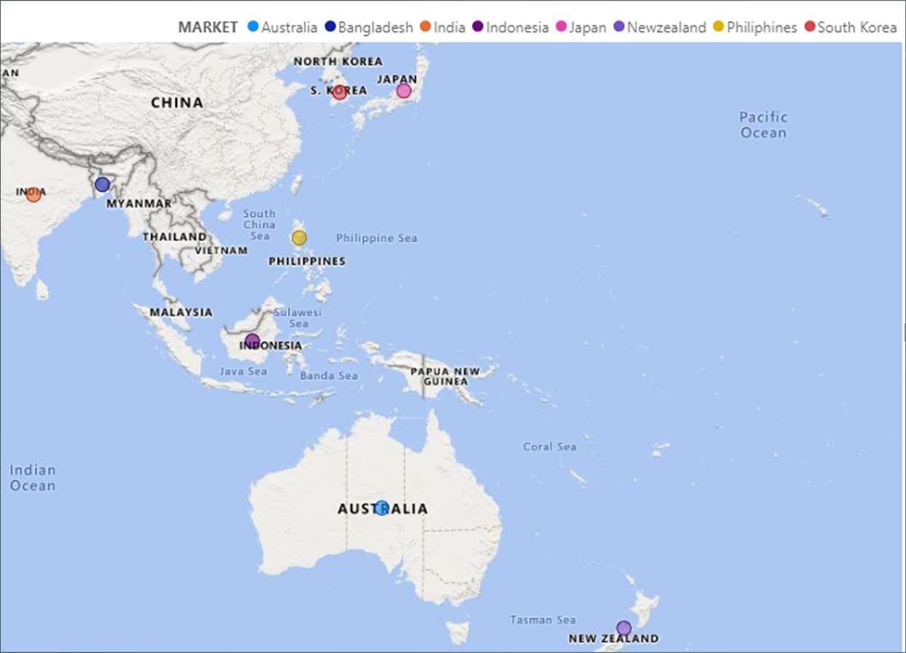
VISUAL:1
Atliq Exclusive: APAC Market Presence
Countries of Operation:
- India
- Indonesia
- Japan
- Philippines
- South Korea
- Australia
- New Zealand
- Bangladesh
Key Insights
- Robust Market Presence: Atliq Exclusive has established a significant footprint across diverse markets in the Asia-Pacific (APAC) region.
- Cultural Adaptability: Demonstrates the ability to successfully navigate and adapt to various cultural and economic environments.

Slide 7
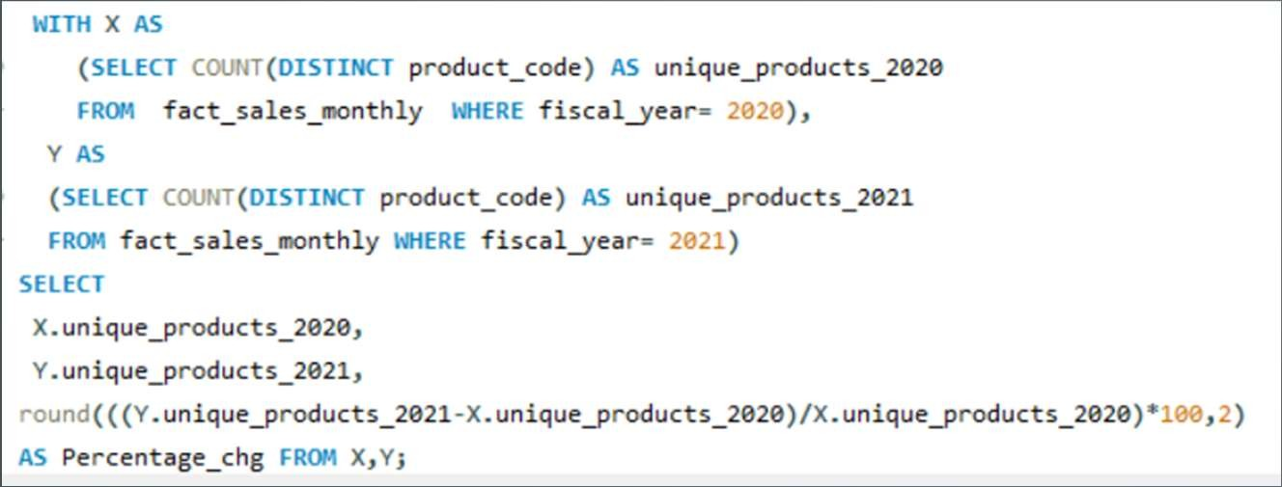
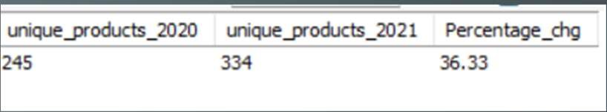
AD_HOC-REQUEST:2
QUESTION:
What is the percentage of unique product increase in 2021vs. 2020?
The final output contains these fields, unique_products_2020 unique_products_2021 percentage_chg
SQL Query
Output

Slide 8







VISUALS-2
Insights
Increase in Unique Products
2020: 245 unique products
2021: 334 unique products
Percentage Change: 36.33% increase
Rise in unique_product 2021vs 2020
Analysis
Significant Growth: The 36.33% increase in unique products from 2020 to 2021 highlights a substantial expansion in product offerings.
Strategic Expansion: This growth indicates a strategic focus on diversifying the product line.
Market Adaptability: Reflects the company's ability to adapt to changing market demands.
Customer Attraction: A broader product range can attract a wider customer base.
Revenue Potential: Potential to boost sales and revenue through an expanded product portfolio.
245
334
unique_products_2020 unique_products_2021

Slide 9
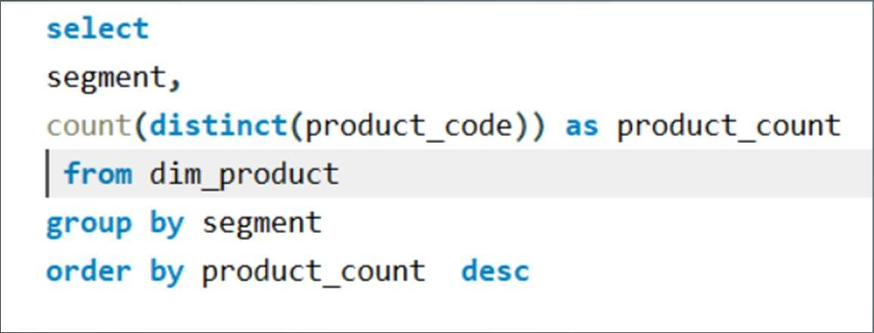
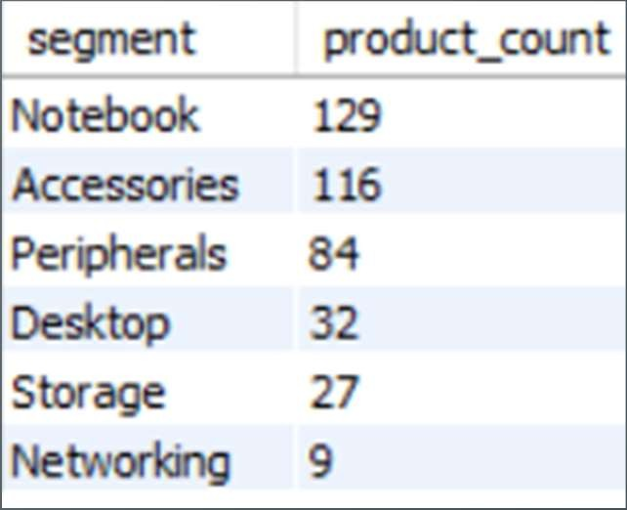
AD_HOC-REQUEST:3
QUESTION:
Provide a report with all the unique product counts for each segment and sort them in descending order of product counts.The final output contains 2 fields, segment product_count
SQL Query
Output

Slide 10














VISUALS-3
Insights
Product Count by Segment
Notebook: 129 products (highest count)
Networking: 9 products (smallest count)
product_count by Segment
Notebook, 129
Accessories, 116
Insights
Diversity in Offerings:
The "Notebook" segment leads with the highest number of products, indicating a broad range of options.
The "Networking" segment has the fewest products, suggesting a more specialized focus.
Segment Analysis:
"Notebook" and "Accessories" segments provide a wide array of choices, catering to diverse customer needs.
Limited selection in the "Networking" segment could indicate niche market targeting.
Customer Focus:
The variety in product offerings allows the company to meet various customer preferences and requirements across different segments.
Peripherals, 84
Desktop, 32
Storage, 27
Networking, 9

Slide 11
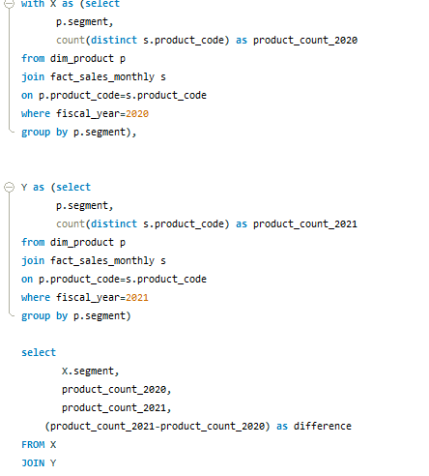
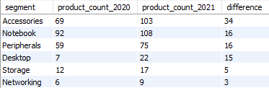
AD_HOC-REQUEST:4
Follow-up: Which segment had the most increase in unique products in 2021 vs 2020? The final output contains these fields, segment product_count_2020 product_count_2021 difference
SQL Query
Output

Slide 12

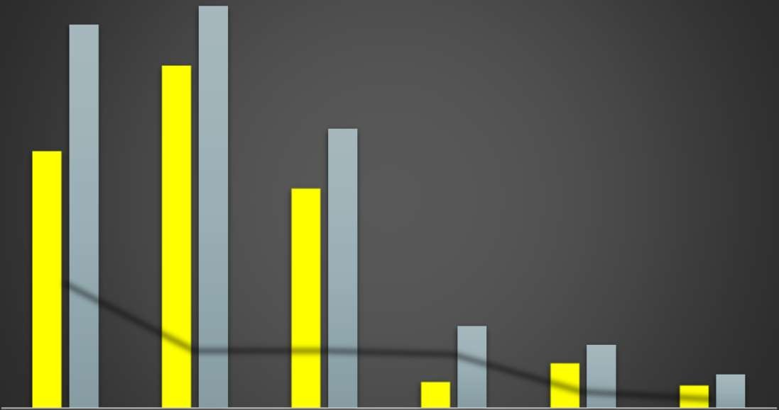
VISUALS 4
Insights
Accessories Segment Growth:
Significant increase in product count, with 34 more products in 2021 compared to 2020.
General Trend:
Overall growth in the product portfolio, particularly in the "Accessories" and "Notebook" segments.
Indicates a strategy to cater to a broader range of customer preferences.
Market Competitiveness:
Expansion in product variety enhances market competitiveness.
Offers customers a wider array of choices, potentially increasing customer satisfaction and loyalty.
product_count trends of segment
103
108
92
69
75
59
34
22
12
17
16
16
7
15
9
3
Networking difference
6
5
Storage
Accessories
Notebook
Peripherals
Desktop
product_count_2020
product_count_2021

Slide 13
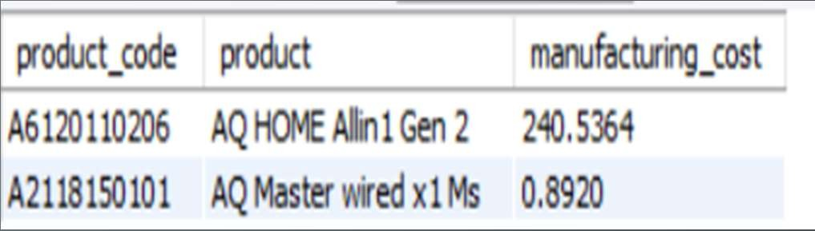
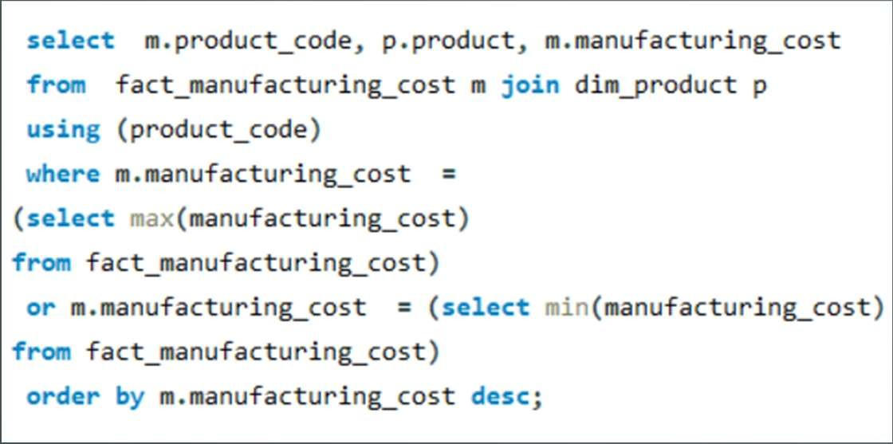
AD_HOC-REQUEST:5
QUESTION:
Get the products that have the highest and lowest manufacturing costs.
The final output should contain these fields, product_code product manufacturing_cost
SQL Query
Output
Insights
"AQ HOME Allin1 Gen 2" has a relatively higher manufacturing cost of 240.5364.
In contrast, "AQ Master wired x1 Ms" has a significantly lower manufacturing cost of 0.892.

Slide 14
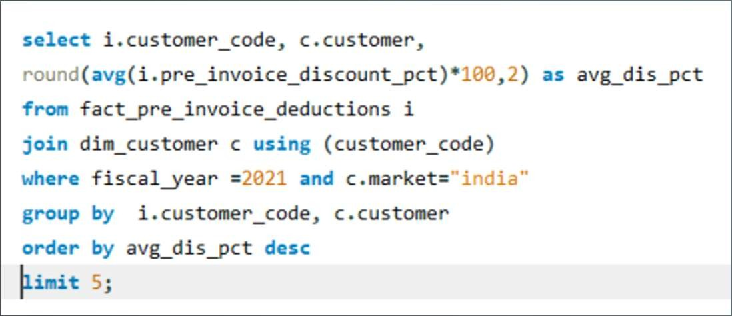
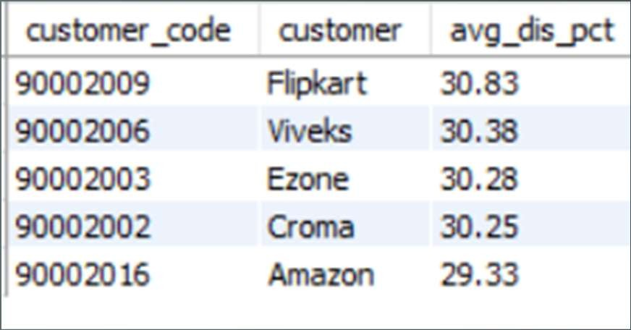
AD_HOC-REQUEST:6
QUESTION:
Generate a report which contains the top 5 customers who received an average high pre_invoice_discount_pct for the fiscal year 2021 and in the Indian market.The final output contains these fields, customer_code customer average_discount_percentage
Query
Output

Slide 15
VISUALS-6
Insights
"Flipkart" has the highest average pre-invoice discount percentage at 30.83%.
"Amazon" has a comparatively lower average discount at 29.33%.
These insights indicate varying discount strategies among customers, with "Flipkart" and "Viveks" offering the highest average discounts, potentially attracting cost-conscious shoppers.
"Amazon" provides relatively lower discounts, suggesting a different pricing strategy or a customer base less sensitive to discounts.
These insights can be valuable for adjusting discount strategies and understanding customer preferences.

Slide 16
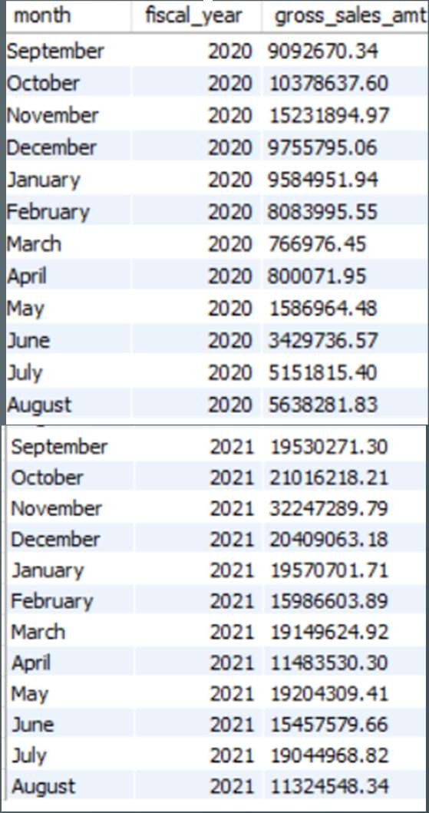
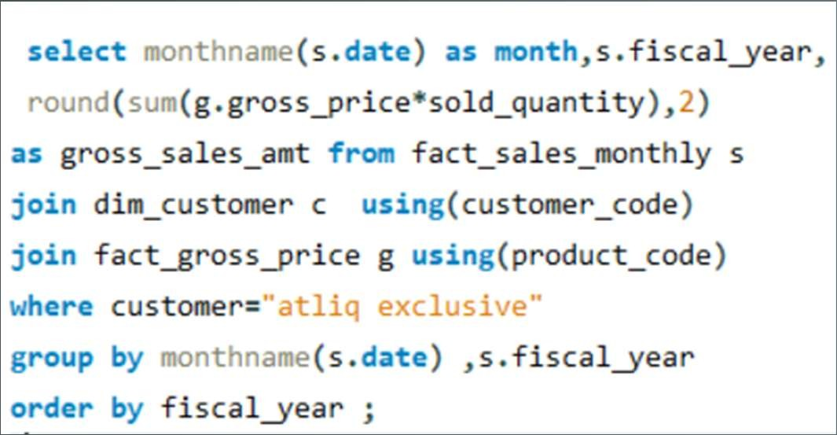
AD_HOC-REQUEST:7
QUESTION:
Get the complete report of the Gross sales amount for the customer “Atliq Exclusive” for each month.This analysis helps to get an idea of low and high-performing months and take strategic decisions.The final report contains these columns: Month Year Gross sales Amount
Output
SQL Query

Slide 17
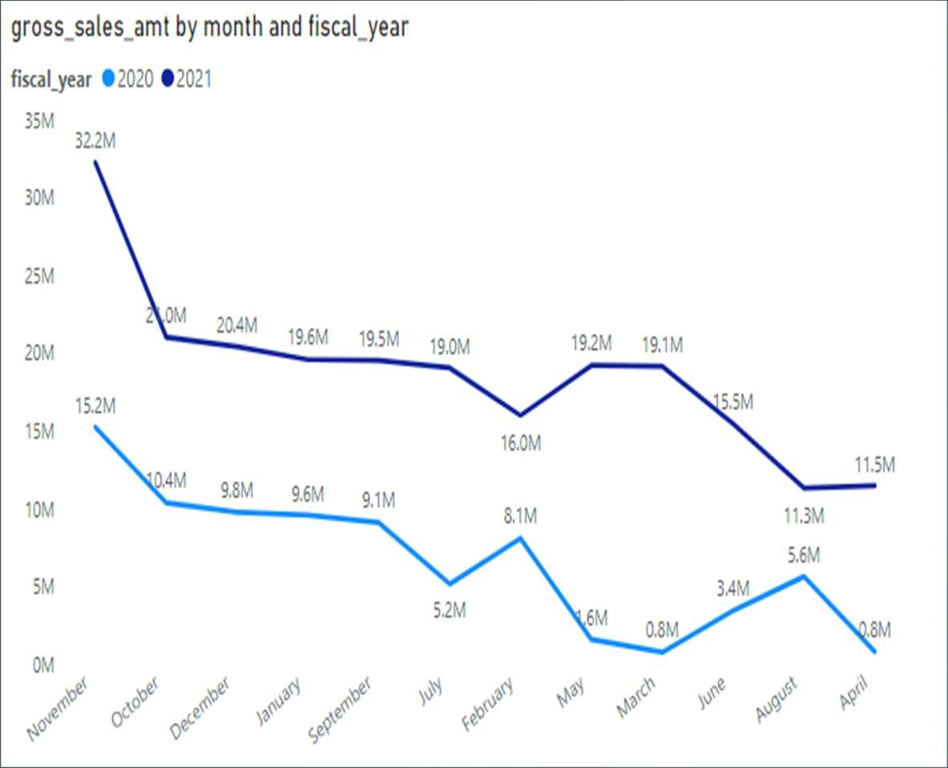
VISUALS-7
Sales Insights
Peak Sales Month:
November 2021 had the highest gross sales, reaching $32,247,289.79.
Sales Trends:
Fiscal year 2021 started with lower sales in September but saw a significant peak in November.
Consistent seasonality observed, with November being a strong sales month.
Year-over-Year Improvement:
March and April in fiscal year 2020 had relatively low sales, which improved in fiscal year 2021.
Strategic Guidance:
Focus marketing efforts and inventory planning around peak sales months.
Address potential challenges during lower sales months.

Slide 18
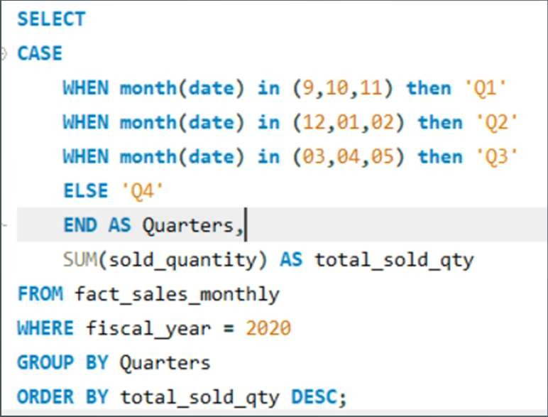
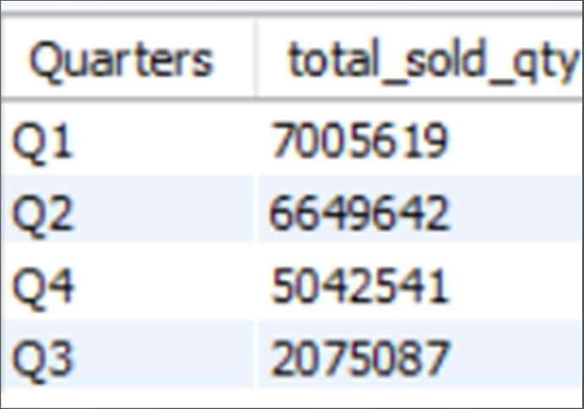
AD_HOC-REQUEST:8
QUESTION:
In which quarter of 2020, got the maximum total_sold_quantity? The final output contains these fields sorted by the total_sold_quantity, Quarter total_sold_quantity
SQL Query
Output

Slide 19
VISUALS-8
Insights
QUATERS VS TOTAL_SOLD_QTY
The highest total sold quantity was in Q1, with 7,005,619 units.
These insights highlight a seasonal variation in sales, with Q1 and Q2 being the strongest quarters and Q3 being the weakest.
This information is valuable for planning inventory and marketing strategies to align with seasonal demand.
7005619
6649642
5042541
2075087
Q1
Q2
Q4
Q3

Slide 20
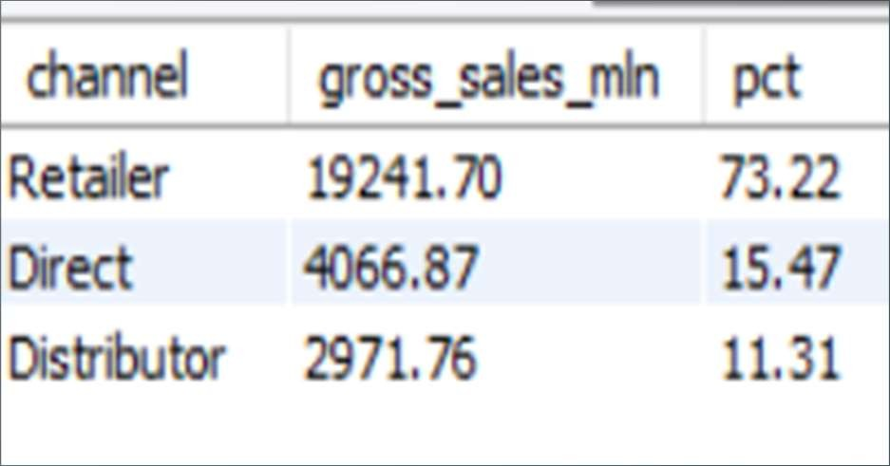
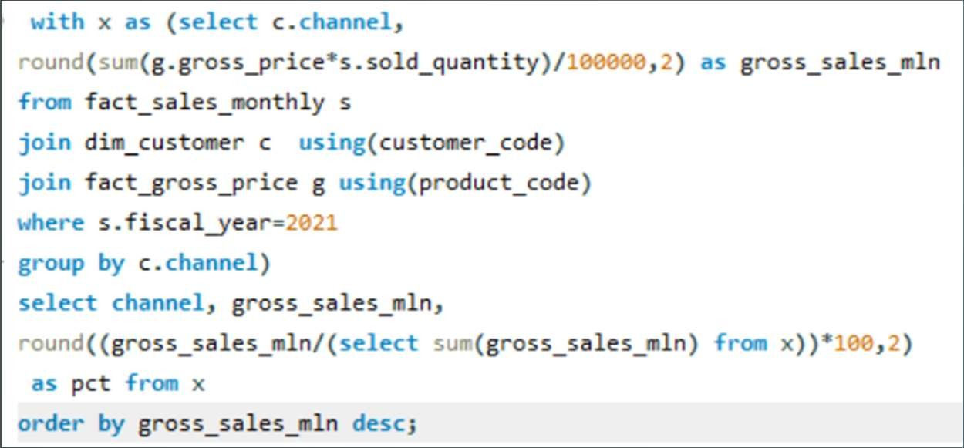
AD_HOC-REQUEST:9
QUESTION:
Which channel helped to bring more gross sales in the fiscal year 2021 and the percentage of contribution? The final output contains these fields, channel gross_sales_mln percentage
SQL Query
Output

Slide 21
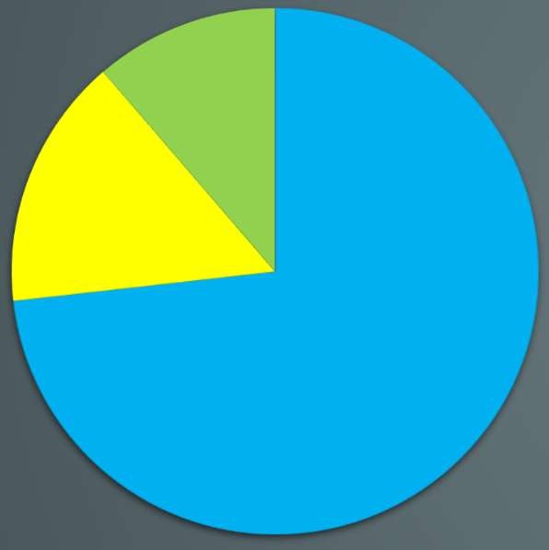
VISUALS 9
INSIGHTS
channel gross_sales contribution
The "Retailer" channel accounts for the majority of sales, contributing to 73.22% of gross sales.
The "Direct" channel also plays a significant role, representing 15.47% of gross sales.
The "Distributor" channel contributes 11.31% of gross sales.
A significant focus on the "Retailer" channel suggests it is the primary revenue driver.
Diversification and growth opportunities may be explored in the "Direct" and "Distributor" channels to further maximize sales.
2971.76,
1%
4066.87, 1%
19241.7, 7%
Retailer
Direct
Distributor

Slide 22
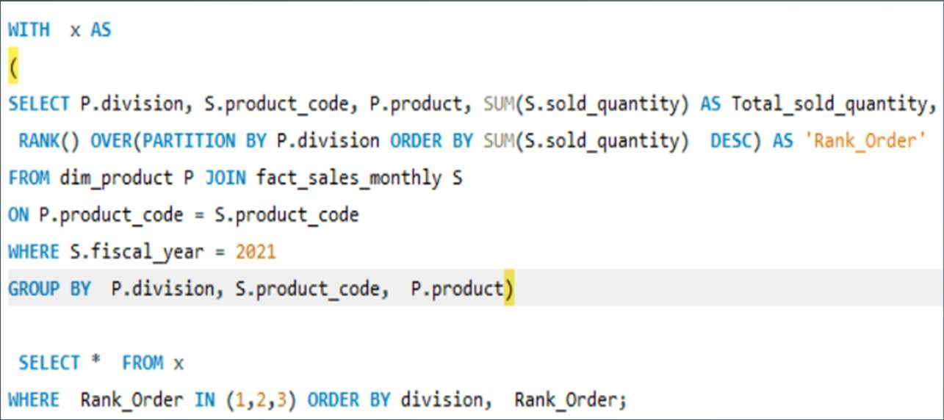
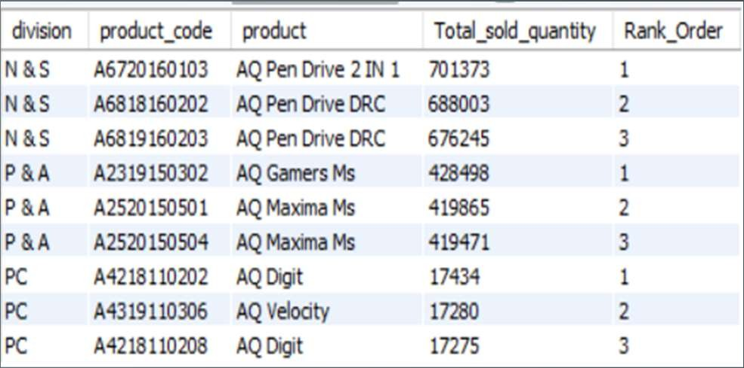
AD_HOC-REQUEST:10
QUESTION:
Get the Top 3 products in each division that have a high total_sold_quantity in the fiscal_year 2021? The final output contains these fields, division product_code
SQL Query
Output

Slide 23




Top 3 sold product in N&S Division
Total_sold_quantity Rank_Order
Top 3 sold product in P & A Division
428498
419865
419471
701373
688003
676245
1
2
3
1 | 2 | 3
428498 | 419865 | 419471
AQ GAMERS MS | AQ MAXIMA MS | AQ MAXIMA MS
A2319150302 | A2520150501 | A2520150504
P & A | P & A | P & A
2
3
AQ PEN DRIVE 2 IN 1 A6720160103
N & S
AQ PEN DRIVE DRC A6818160202
N & S
AQ PEN DRIVE DRC A6819160203
N & S
Total_sold_quantity
Rank_Order

Slide 24


Top 3 sold product in PC Division
17434
17280
17275
1
2
3
1 | 2 | 3
17434 | 17280 | 17275
AQ DIGIT | AQ VELOCITY | AQ DIGIT
A4218110202 | A4319110306 | A4218110208
PC | PC | PC
Total_sold_quantity
Rank_Order

Slide 25
tHANKYOU

